Slide 1
Time Series Fundamentals
ACFs, PACFs and ARIMA Models
Part 1

Slide 2
Step 1: Nature of Time Series
We’ve been introduced to moving averages (MA), autoregressive processes (AR) and the idea of stationary series. Now we are going to put them all together in a single time series model – ARIMA models.
In order to do that, we will need to explore the world of ACF and PACF functions a little more as well. We were introduced to these handy things in the last lecture, but time to learn to interpret them a bit more closely.

Slide 3
Step 1: Nature of Time Series
Example 1: Skitters weight control company has data on its monthly sales for the last 3 years. Company officials want to know if you can model that data and predict the next 12 months of sales.

Slide 4
Step 1: Nature of Time Series
Example 2: Skitters weight control has 3 years of advertising costs and wants to know what you think next years advertising costs might look like.

Slide 5
Step 1: Nature of Time Series
Example 3: Skitters weight control has 3 years of advertising costs and sales and wants to get a better idea of the relationship between the two, as well as forecast this relationship into the next 12 months.

Slide 6
Analytical Tools

Slide 7






Step 1: Time Series Brought to You By…
Time series analytics brought to you today by GRETL
Other time series platforms

Slide 8
Typical Use, Data Sniff and IDRE

Slide 9
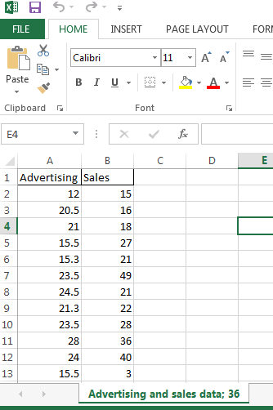
Step 2: Inspect the Data
Time series data in companies is often is found in Excel spreadsheets so you can use GRETL to read in these data sets.
Note that GRETL as well as most of the other platforms mentioned are a bit persnickety about time fields.
Notes:
If students will be required to write a research proposal or conduct a study as a course project, or if students have ongoing research projects such as theses or dissertations, and if the class is reasonably small, it may be useful to elicit descriptions of their research interests early in the course and use these research questions as a focus for discussion. If the class is large or students do not have well defined research interests, you may want to focus discussion on the empirical examples presented in the chapter.

Slide 10
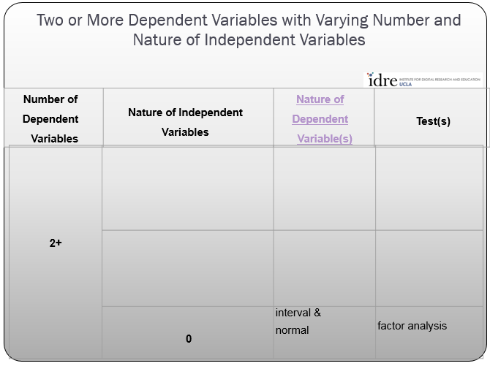
Step 3: Analysis Run
a. Determine the technique to use from idre chart
Sadly, the IDRE chart fails us here. They don’t list time series in the chart. But we can do it here ourselves.
1
Typically Interval
ARIMA models
0 or more

Slide 11
Step 3: Analysis Run
ARIMA Paremeters
There are three parameters for ARIMA models – autoregressive (p), differencing (d) and moving average (q) or ARIMA(p,d,q).
Here is an example of an ARIMA model specification where there is a first order autoregressive process, a first order differencing and a first order moving average
ARIMA (1,1,1)

Slide 12
Step 3: Analysis Run
ARIMA Parameters
Remember that moving averages can be first order, second order, etc. If you think the moving average process goes back two time periods then the ARIMA model might look like this:
ARIMA (1,1,2)

Slide 13
Step 3: Analysis Run
ARIMA Parameters
If you think the autoregressive process goes back 2 time periods then the ARIMA model would look like this and there would be two autoregressive terms in the model – one for the time period t-1 and one for time period t-2.
ARIMA (2,1,1)

Slide 14
Step 3: Analysis Run
ARIMA Parameters
Remember that we need to work with stationary time series in our time series models. That is, there should be no slope (e.g. constant mean) in our data. In real life remember that often this is not the case – sales go up over time or the price of a stock goes down over time, etc.
The middle parameter in the ARIMA specification is the differencing parameter. Remember how last time we differenced the data manually to remove the trend? Well, ARIMA thoughtfully will do that for you if you put a 1 in the middle (d) parameter as seen here below.
ARIMA (2,1,1)

Slide 15
Step 3: Analysis Run
ARIMA Parameters
Remember that we need to work with stationary time series in our time series models. That is, there should be no slope (e.g. constant mean) in our data. In real life remember that often this is not the case – sales go up over time or the price of a stock goes down over time, etc.
The middle parameter in the ARIMA specification is the differencing parameter. Remember how last time we differenced the data manually to remove the trend? Well, ARIMA thoughtfully will do that for you if you put a 1 in the middle (d) parameter as seen here below.
ARIMA (2,1,1)

Slide 16
Step 3: Analysis Run
ARIMA Parameters
Don’t need differencing or a moving average process? For any of the ARIMA(p,d,q) you can put zero.
Here is an ARIMA model where the data is already stationary (e.g. no trend, etc.) and there is no moving average in the model, just a first order autoregressive term.
ARIMA (1,0,0)

Slide 17
Step 3: Analysis Run
ARIMA Parameters, ACF and PACF
Automated ARIMA model identification - this one of those “I walked ten miles in the snow to go to school” stories when there is a car to take me there?
It really will help you understand the processes at work if you do the work yourself and on occasion the model you come up with may not be what your automated procedure suggests.
So it’s time to return to our old playpals – the autocorrelation function (ACF) and the partial autocorrelation function (PACF) to help us decide how to set our ARIMA model parameters.

Slide 18
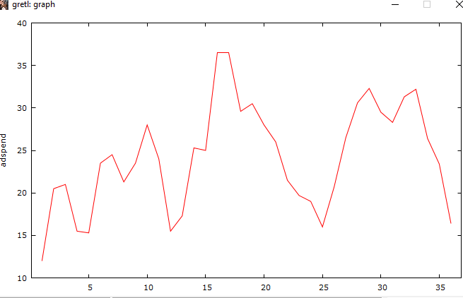
Step 3: Analysis Run
ARIMA Parameters, ACF and PACF
Remember we are interested in specifying our three ARIMA parameters – ARIMA(p,d,q). First let’s look at our advertising spend data…
Does it look like there is a trend we need to difference?

Slide 19
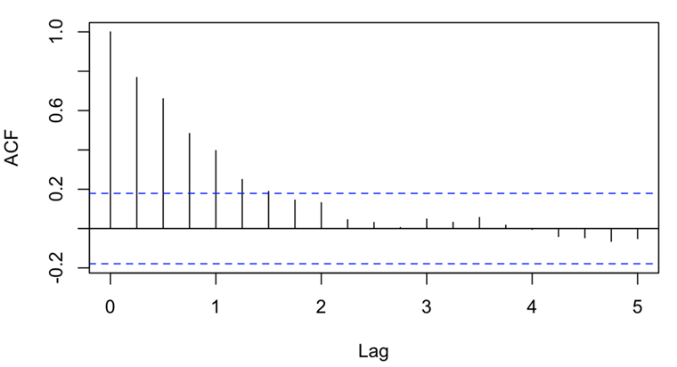
Step 3: Analysis Run
ARIMA Parameters, ACF and PACF
Now let’s try another tool to see if the mean is stationary – ACF plot. Here is what a typical ACF plot looks like for a non-constant mean or trend in the data.
Typical ACF for trend in data

Slide 20
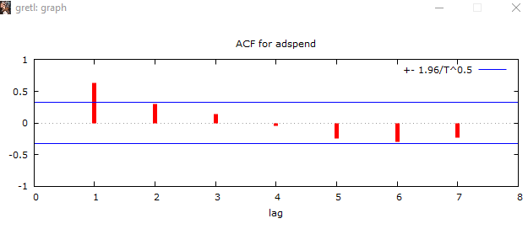
Step 3: Analysis Run
ARIMA Parameters, ACF and PACF
What does our ACF look like for our ad spend data? It does seem to match our ski slope pattern and suggests non-constant mean.

Slide 21
Step 3: Analysis Run
ARIMA Parameters, ACF and PACF
So we’ve tried the mark I eyeball test and then secondly looked at the ACF graph – are there any actual tests I can use to see if there is a non-constant mean? Yes there are!
In GRETL there are the Augemented Dickey Fuller test and the KPSS test.

Slide 22
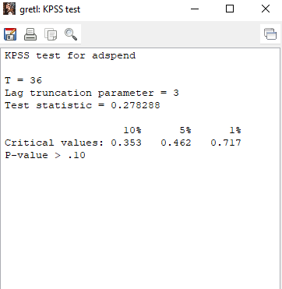
Step 3: Analysis Run
ARIMA Parameters, ACF and PACF
Let’s look at the KPSS test first because it is more straightforward.
The null and alternative hypotheses for KPSS are
Hnull: constant mean
Halt: non-constant mean
What does our KPSS test show?
No evidence of non-constant mean or trend

Slide 23
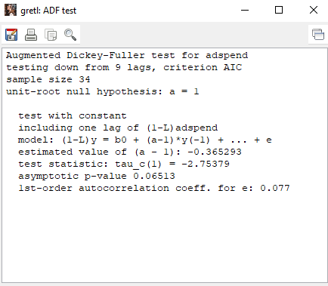
Step 3: Analysis Run
ARIMA Parameters, ACF and PACF
Let’s look at the Augmented Dickey Fuller (ADF) test next.
The null and alternative hypotheses for ADF test are
Hnull: non-constant mean
Halt: constant mean
What does our ADF test suggest?
Oh no!!! Just the opposite of KPSS! Kill me now!

Slide 24

Step 3: Analysis Run
ARIMA Parameters, ACF and PACF
So what do we do now? In summary:
The following suggest non-constant mean or trend
Eyeball test with trend line
ACF plot
Augemented Dickey Fuller test
Only the KPSS test suggests no evidence of non-constant mean or trend.
The solution is to be conservative and if two or more of the indicator suggest non-constant mean then declare that and now to fix this

Slide 25
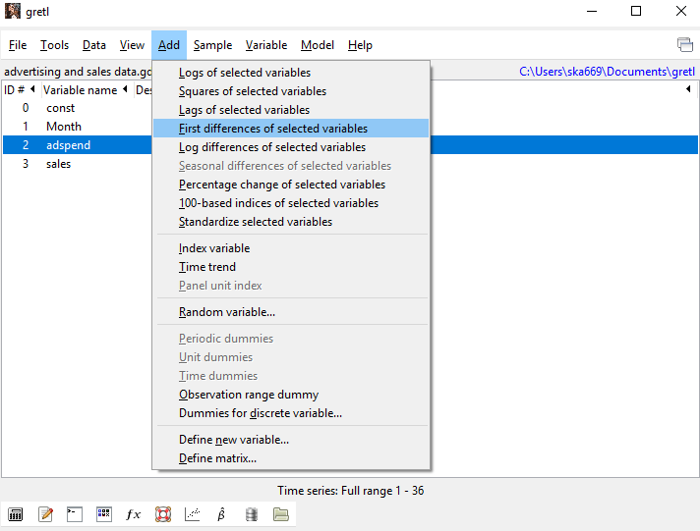
Step 3: Analysis Run
ARIMA Parameters, ACF and PACF
So we are going to have to difference the ad spend variable. Let’s do that now!

Slide 26
Step 3: Analysis Run
ARIMA Parameters, ACF and PACF
There is the differenced variable now!

Slide 27
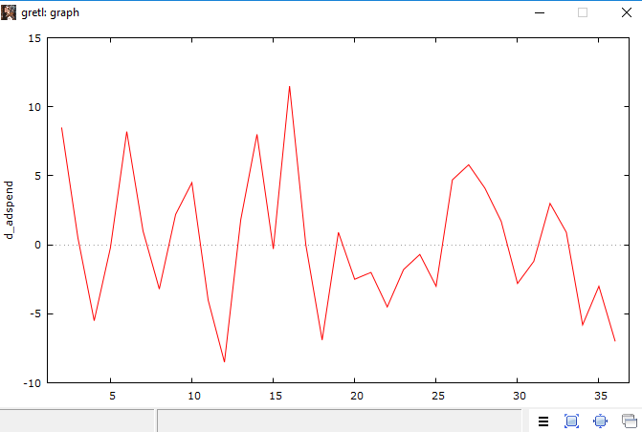
Step 3: Analysis Run
ARIMA Parameters, ACF and PACF
Let’s use our Mark I eyeball to see if the trend went away in our differenced variable?

Slide 28
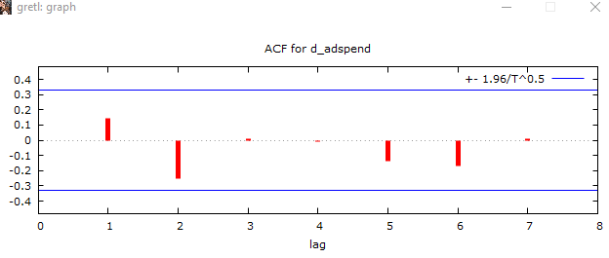
Step 3: Analysis Run
ARIMA Parameters, ACF and PACF
What does our ACF look like for our differenced ad spend data? The skis slope pattern is gone! Now it looks more like the “flip flop” pattern we would suggest where there is a constant mean.

Slide 29
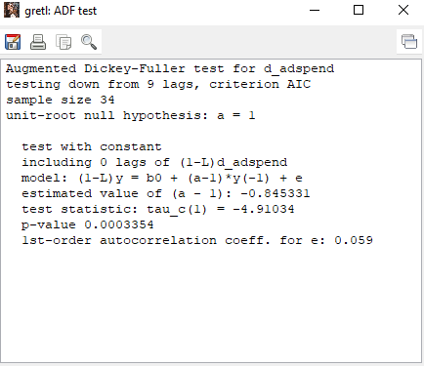
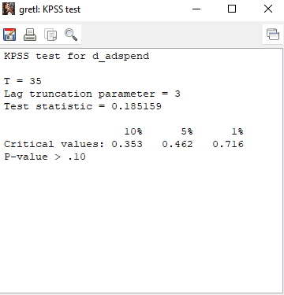
Step 3: Analysis Run
ARIMA Parameters, ACF and PACF
Let’s look at the Augmented Dickey Fuller (ADF) and KPSS tests and see if the trend is gone. Yes it is!

Slide 30

Step 3: Analysis Run
ARIMA Parameters, ACF and PACF
Now we can move on to Part 2 of the ARIMA analysis process!

Slide 31
Step 7: Sample Size and Power
Most stat textbooks recommend a minimum of 50 observations for working on time series models…
Technically discussions of power and time series often do not mix very easily. The more cases one has (see #1 above) the more power the ARIMA model will have to find statistically significant AR and MA processes.

Slide 32
Step 8: Assumptions of the Test
The two most classic assumptions of ARIMA models are:
The time series data is at least weakly stationary
Constant mean over time
Constant variance over time
Homoskedasticity of residuals

Slide 33
Step 9: Notes
Note that the interpretation of the ACF and PACF are subjective to some degree. Note that in my example I ignored the seasonality component of sales in those diagnostic plots. There is a non-trivial amount of discretion often involved in forming some types of time series models.
There are other software packages (the freeware GRETL for example) that have more complex time series models available

